Slide 1
Captcha-Shield SDP 2021 MDR
By: Team 24
Faculty Advisor: Professor Dennis Goeckel

Slide 2
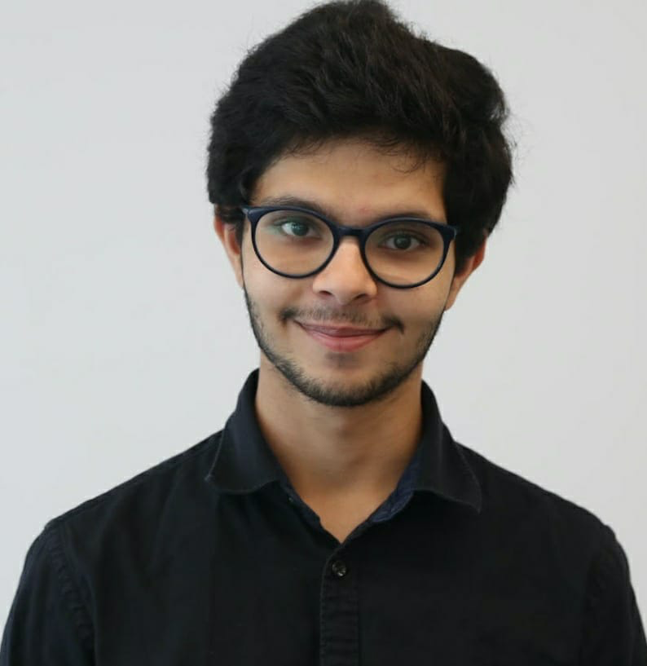
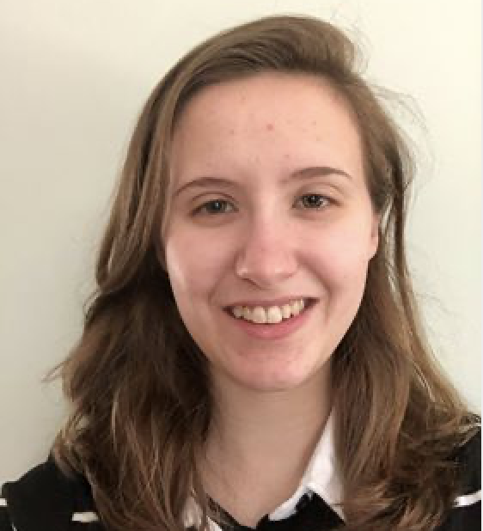
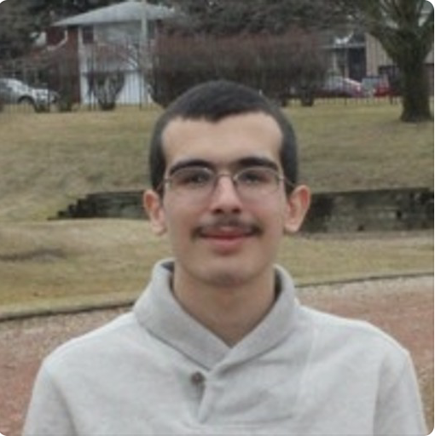
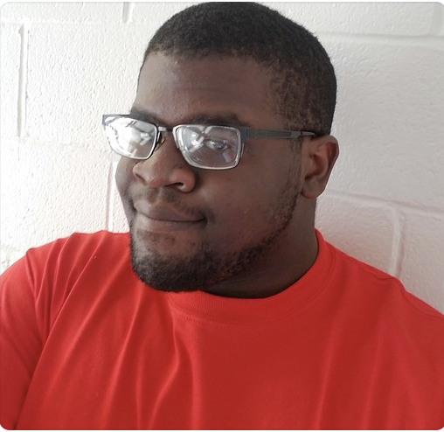
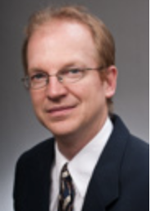
Team 24
Rushiv Arora
CS/CompE
Team Coordinator
Jennifer Gosselin
EE
Altium Lead
Hirad Tabatabaei
EE
Chidinma Ejiofor
CompE
Budget Managements
Professor Dennis Goeckel
Faculty Advisor

Slide 3



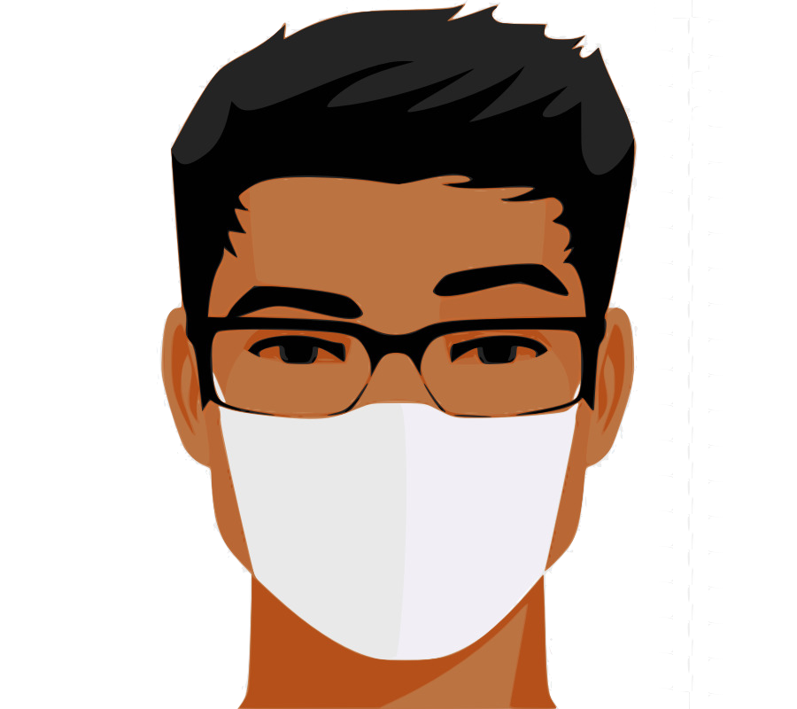
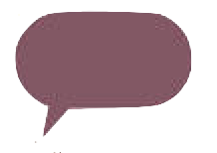
Problem Statement
“With the onset of the Covid-19 pandemic, the world was forced to wear face masks in public, highlighting an issue faced by professionals who wear masks for their jobs: muffled voices and incomprehensible speech, especially for those with hearing impairments.”
“Captcha-Shield will be a lightweight speech-to-text system that sits on custom face shields and prints audio-to-text on screens to better help people, especially those with hearing impairments, understand their mask wearing counterparts.”
Can you hear me?

Slide 4
Updated System Specifications
Performance
Battery Life of at least 1 hour on full charge
Power up in 3 seconds
Power down in 3 seconds
Features
Can capture 80 wpm or more ¹
Bluetooth Low Energy Connectivity
Bluetooth iAP, SDP, A2DP Protocol Connectivity
Text readable from 6ft
Cost
Project Cost [$240.78]
Production Cost [$25.89]
Weight
[Limit 200 Grams]
Not Compromised Shield Safety
Notes:
Dom Barnard. “Average Speaking Rate and Words per Minute.” Virtualspeech.Com, VirtualSpeech, 20 Jan. 2018,

Slide 5
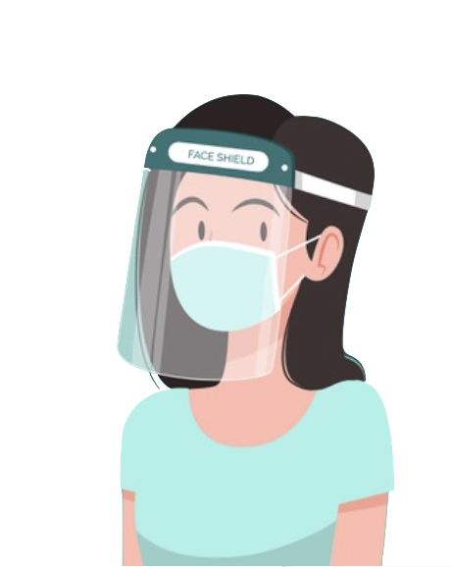

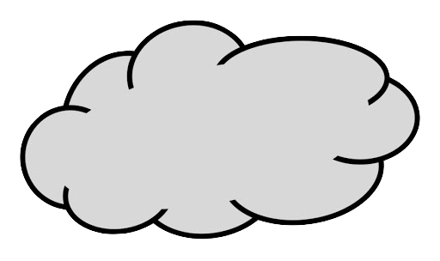
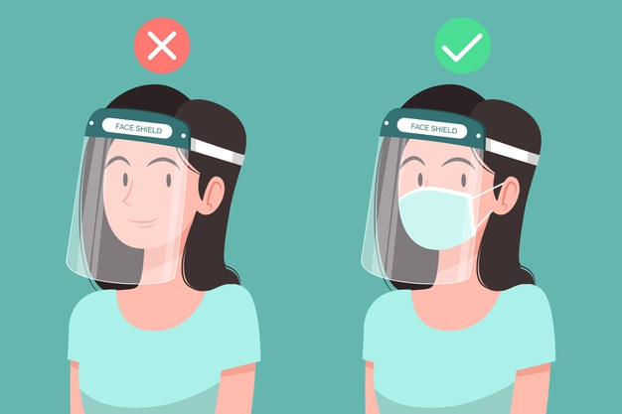
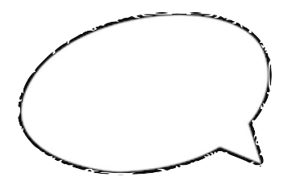
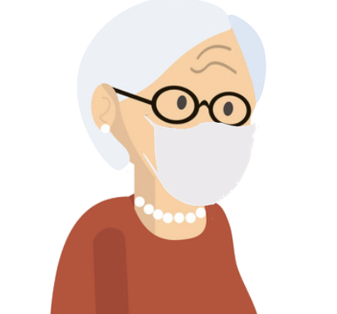
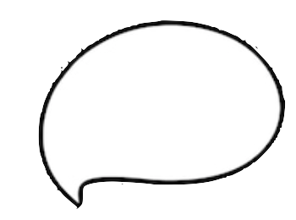
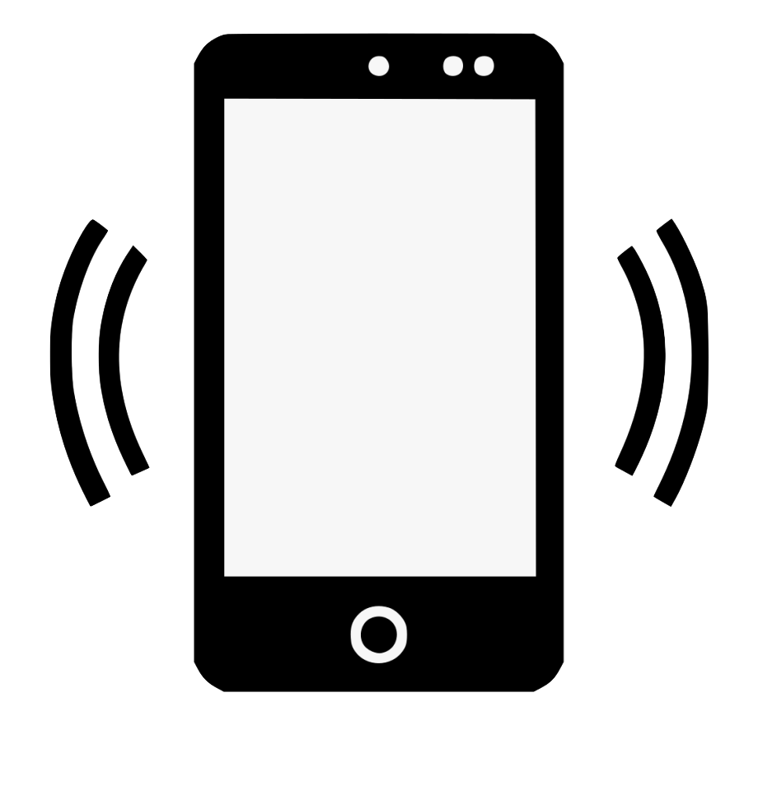

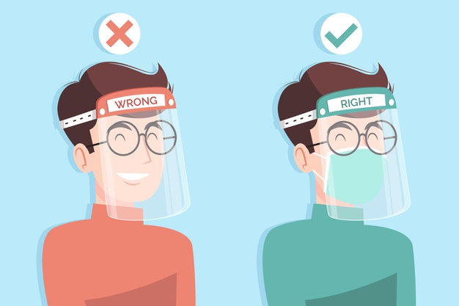
Our Solution: Captcha-Shield
Cloud
World
World
Hello
Hello
6 ft
Notes:
Ask Professor/Team on which alternate image is better

Slide 6
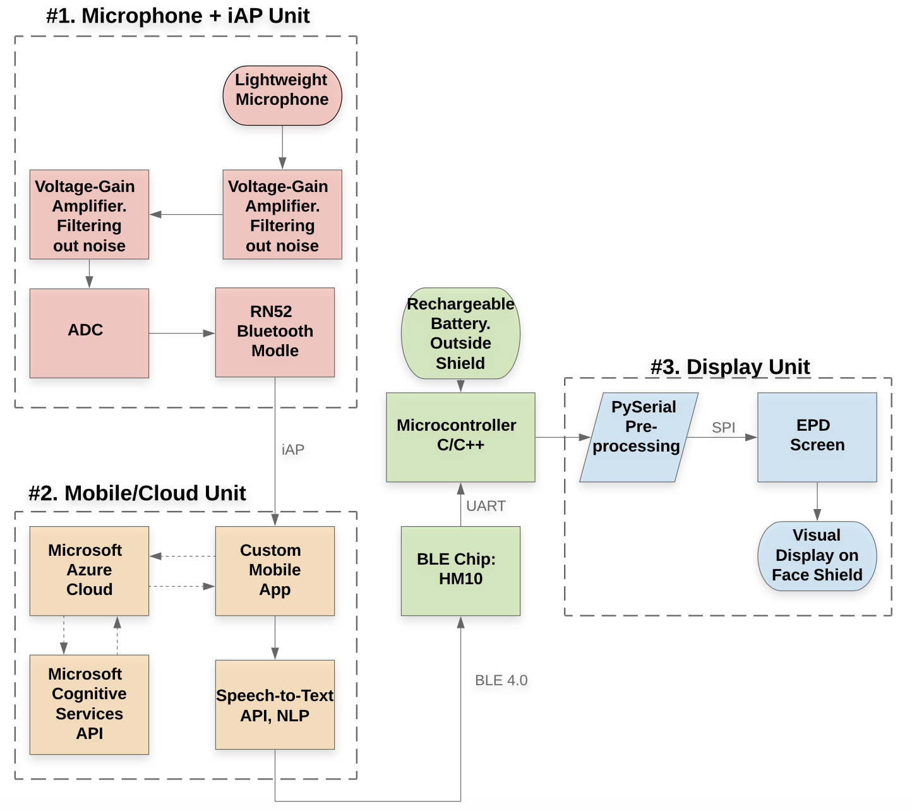
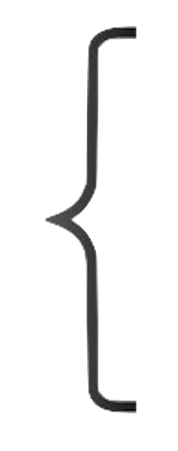

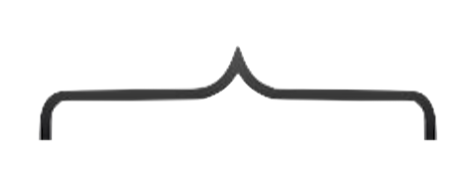
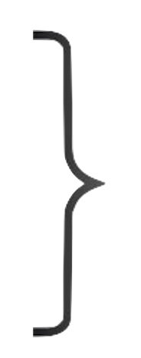
Updated Block Diagram/System Specifications
Located on the inside side of the Shield
Hardware located on the inner side of the Shield
Hardware located on the outer side of the Shield
Mobile Phone located at most 30 ft away from the person.
Server located remotely on the US East Coast

Slide 7
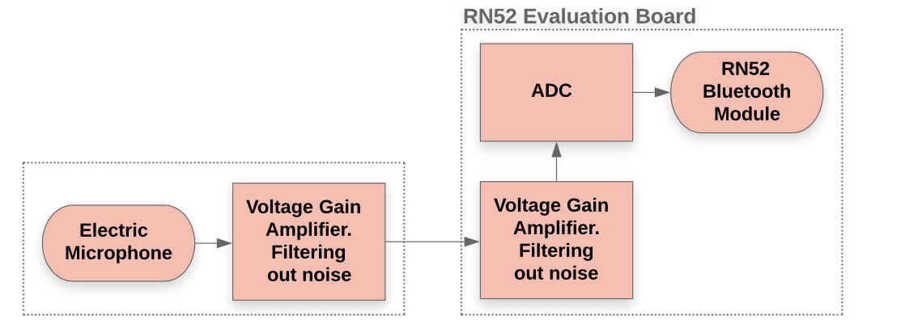
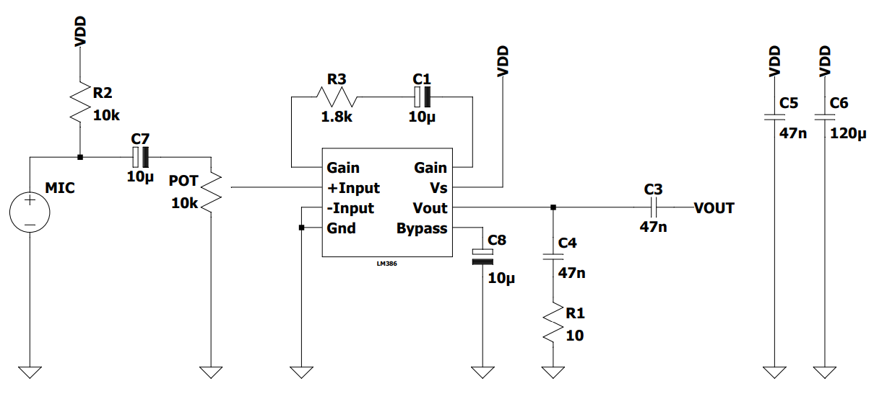
Updated Hardware Design
Microphone directly connected to evaluation board
No preamplifier
Two amplifiers to limit noise while maintaining gain

Slide 8
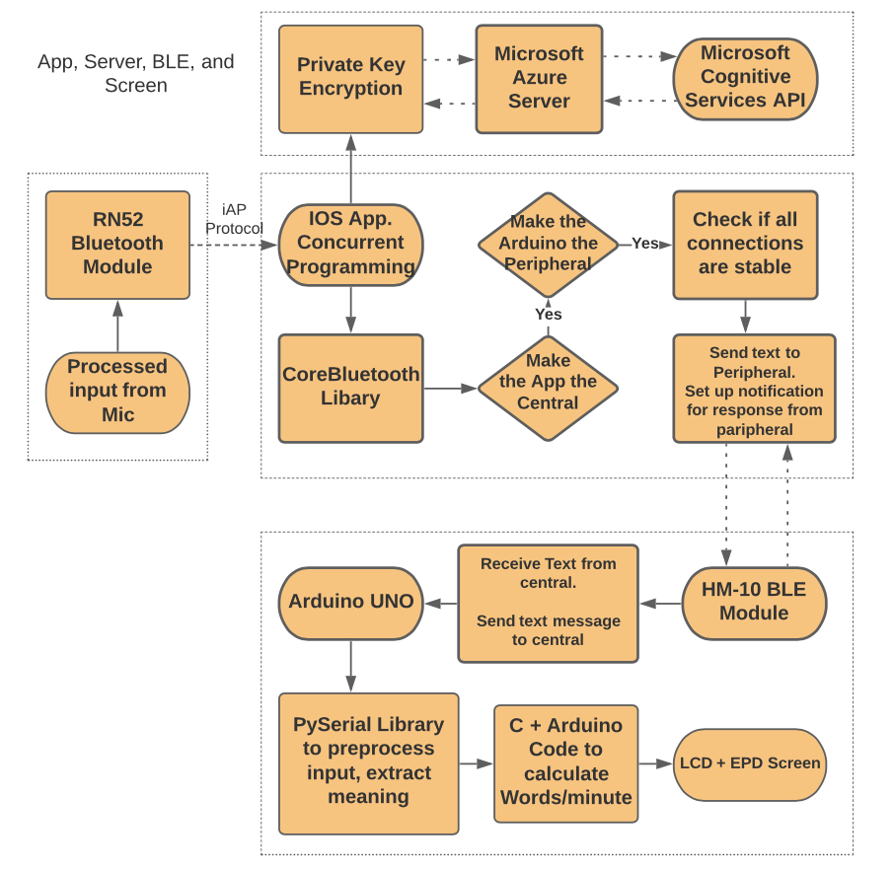
Updated Software Diagram
API Located on the Cloud
Application located on the phone
Input coming from hardware on Shield
System Located on the Shield

Slide 9
MDR Deliverables
By MDR the three subsystems will be complete
The Microphone Unit
The Mobile/Cloud Unit
The Display
Jennifer
Selecting electrical components
Scaling the electrical impulse from microphone
Hirad
Selecting electrical components
Filter Design
Converting analog to digital signal

Slide 10
MDR Deliverables
Rushiv
Selecting appropriate cloud platform
Host a Speech-to-Text API on the cloud and apply Natural Language Processing for post-processing
Adjust the parameters to avoid over/under fitting
Connect a Mobile Device to the server
Chidinma
Select appropriate LED/LCD screen
Print messages on the LED/LCD screen Adjust the speed and font to 75-100 wpm and 25+ pt.
Set up bluetooth connections and run dummy tests from a mobile phone

Slide 11
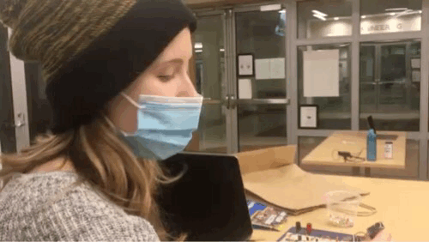
MDR Accomplishments - Team
Created a functional end-to-end prototype of the system
Taking a Preprocessed Microphone Input, and directly sending that microphone input over bluetooth.
Receiving the Audio input on an IOS app created for SDP. Controlling bluetooth and server connections in the app.
Sending the unwrapped iAP audio to the server and receiving text back
Sending the text over BLE to an Arduino UNO, and performing calculations to appropriately display on EPD screen

Slide 12
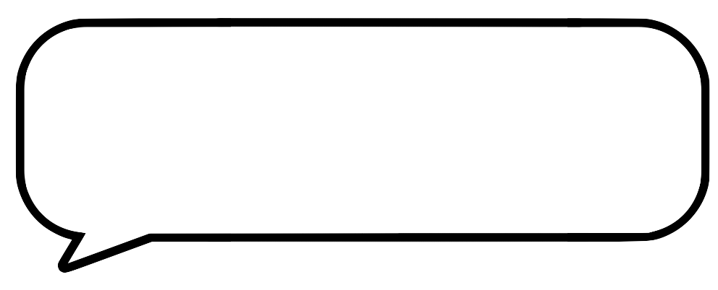

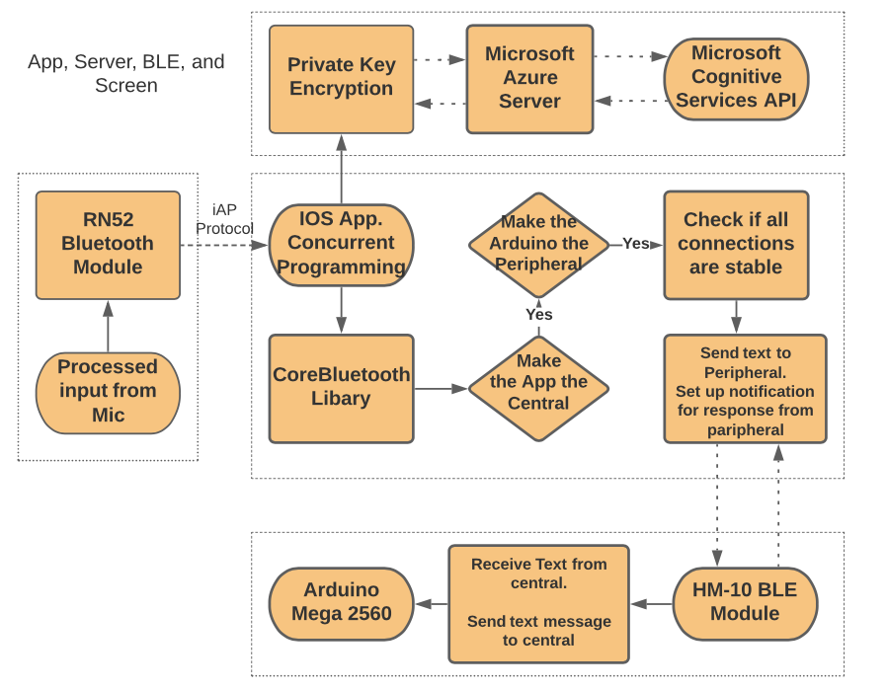
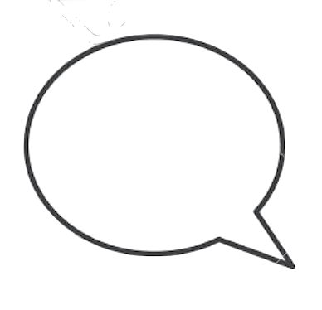

MDR Accomplishments - Rushiv
The server needs private key encrypted authentication. MCS API was selected since it is swift enabled and returns text avoids reading JSON files like all other APIs
The App:
1) Connects to the RN52 Audio and the HM10 BLE modules
2) Redirects the mic to the RN52
3) Connects to the server using private key encryption
4) Prints all speech to text on the phone
5) Will use concurrent programming to be dynamic
The RN52 uses the iAP and SDP protocols for Audio
The HM10 module connects to the Arduino using UART and receives the converted text back

Slide 13
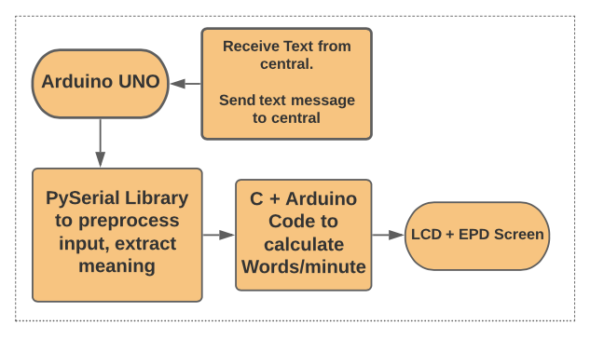
MDR Accomplishments - Chidinma
Developed size adjustment and speed adjustment functions that respond to a raw string
Created a limited test environment in order to test serial communication via Pyserial Library
Successfully printed text forward to the EPD screen
Successfully parsed dynamic string into a an array of words

Slide 14
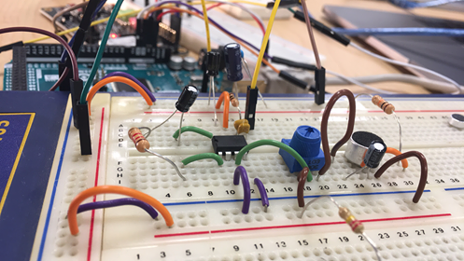
MDR Accomplishments - Jennifer
Created Amplifier to test the EC microphone in different test conditions for the face shield
Designed an Amplifier using a LM386 IC and an EC microphone
Worked in SDP lab to optimize the design using high pass filters for limited noise
Passed signal into the Evaluation board for further amplification and ADC conversion
Signal was too noisy and the Amplifier’s gain was reduced and cascaded with evaluation board
Hooked up the breakout board microphone to evaluation board for quick testing

Slide 15
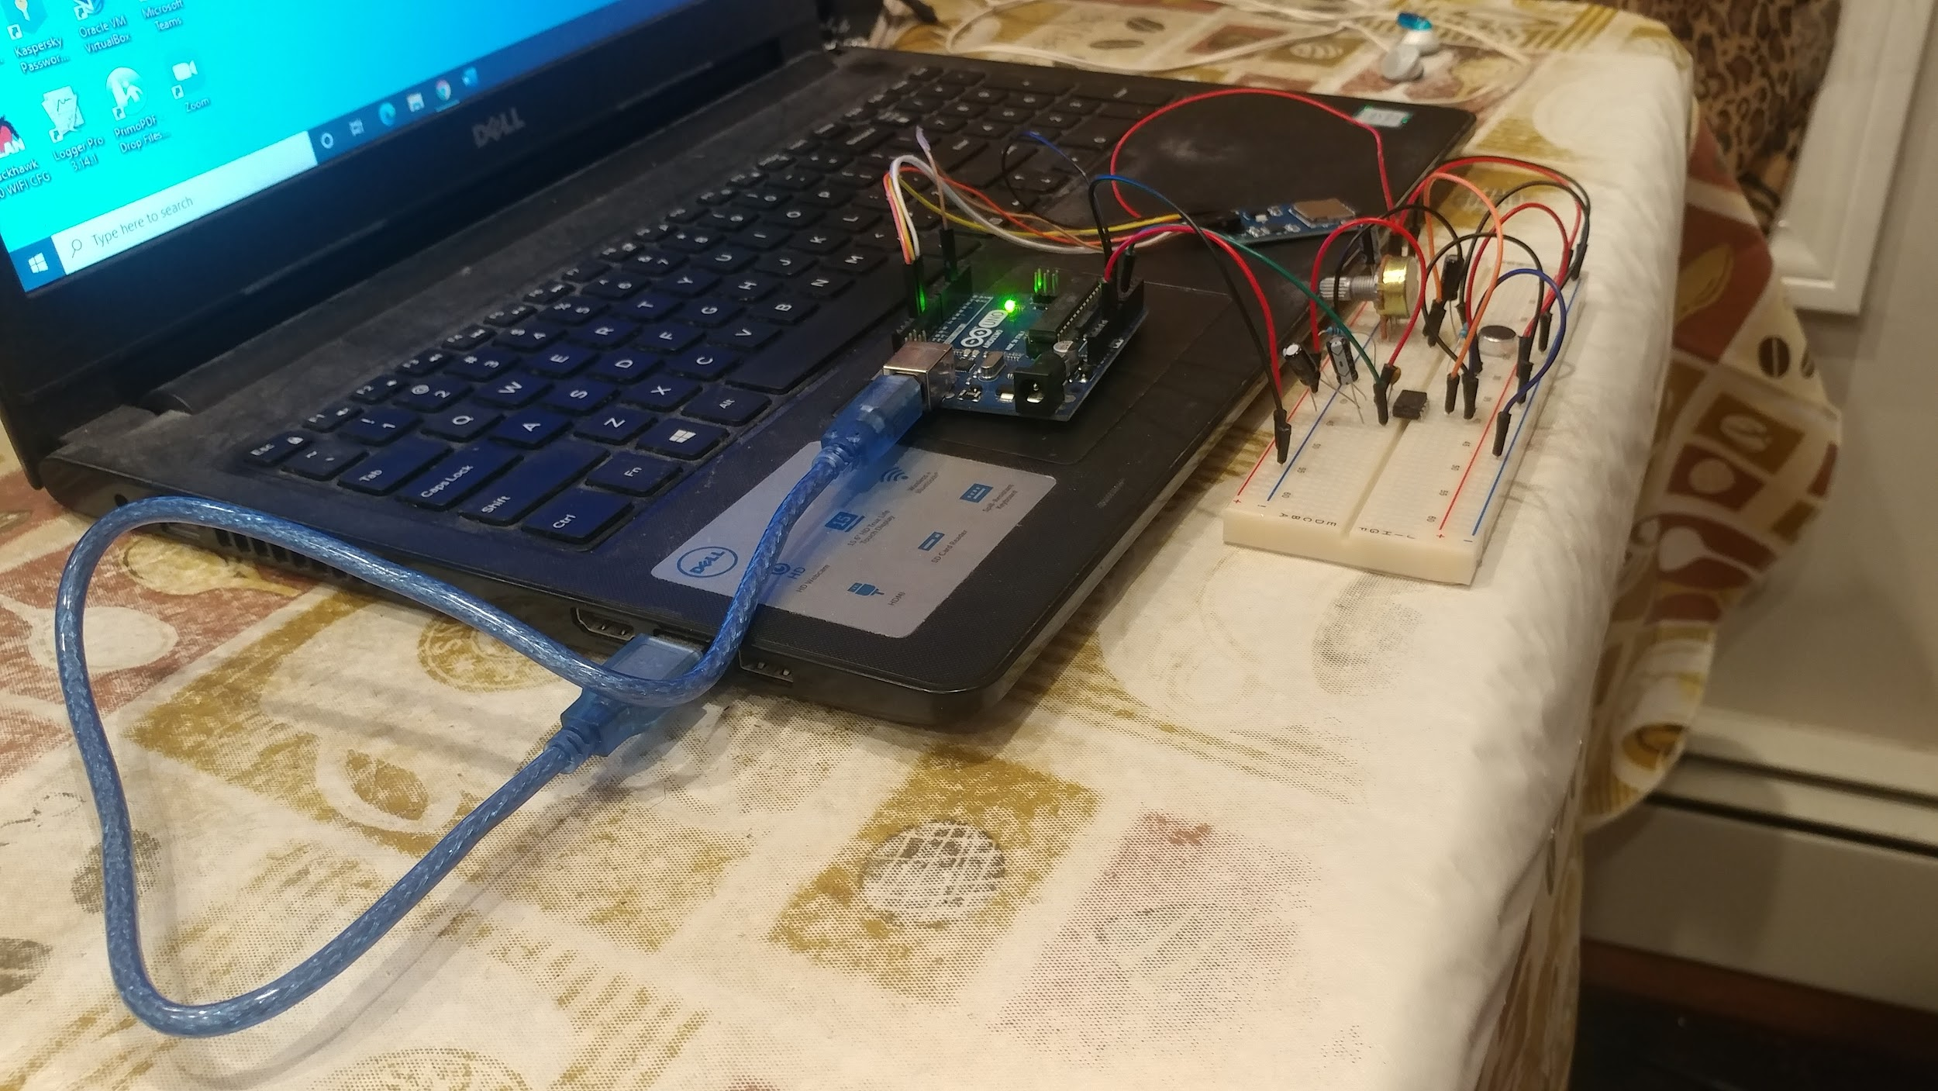
MDR Accomplishments - Hirad
Designed a high-pass filter for accurate capturing of the voice and helped to set up the connection between the circuit and the ADC of the RN52 Bluetooth module
Debugged and resolved issues with
the circuit
Developed a voice recording system
using Arduino’s ADC and a SD card*
This is not part of the final product for MDR and onwards due to the redundant complexity it added to the product. However, voice files are available for demonstration

Slide 16

Demonstration
1)
2)

Slide 17
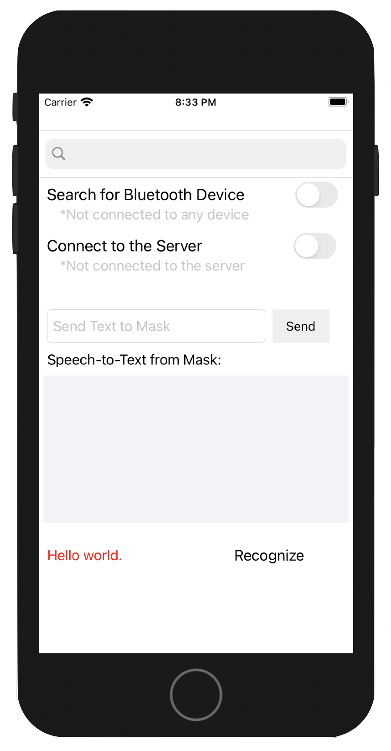
Software and Hardware used for MDR
Software
N52, HM10 Configuration system (CMD) + Teraterm
XCode IDE - Swift Language
OnlineGDB
Arduino IDE
Pycharm
Hardware
Arduino Mega 2560
Arduino Uno
Bluetooth RN52 Evaluation Kit
Bluetooth HM10 Module Breakout Board
2.13 EPD Monochrome Screen
Electret Microphone Amplifier - MAX9814
LM386-1 (Audio Amplifier)

Slide 18
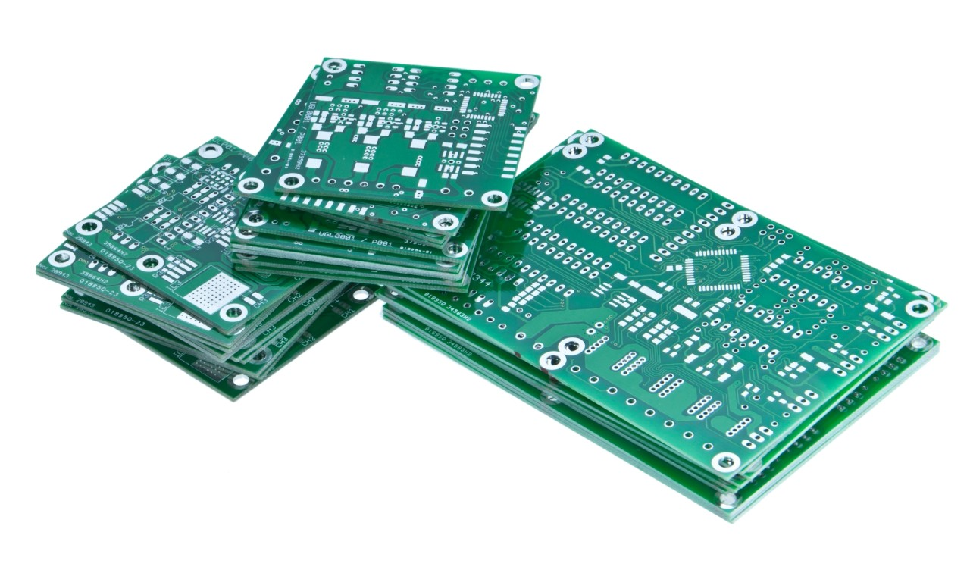
Hardware plan for FPR
On PCB
Amplifiers
IC Audio Amplifier
Capacitors
Resistors
EC Microphone
Microprocessor (ATSAMD21G15B-AU)
RN-52 Audio Bluetooth, HM10 BLE
Off PCB
Battery
EPD screen
Going forward
The amplifiers will be designed for a specific/adjustable gain
When low noise is a achieved the signal will be converted to digital for processing
The power consumption will be determined and a battery chosen for at least one hour
The Altium layout will be created and assembled

Slide 19
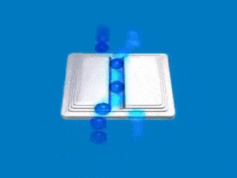
Software Plan for FPR
Going forward:
Program the App concurrently so that it can receive audio, process it, and send text back like a dynamic pipeline of data
Program the ATSAM microcontroller with the be loaded with the Arduino and C functions. Add interrupts or concurrent programming to the MC to receive text and print at the same time
Integrate Pyserial Preprocessing to the iOS App
Publish the App on the App Store
Improve the front end of the App

Slide 20
Current Expenditure
Item | Quantity | Cost [$] Per Unit | Cost [$] Total
RN52-EK Evaluation Kit | 1 | 79.99 | 79.99
RN52 Breakout Board | 1 | 46.95 | 46.95
Microsoft Azure Cognitive Service | < 5 hours | free < 5 hours 0.2 per hour > 5 hours | 0
Microphone | 5 | 0.69 | 3.45
Wired Microphone | 5 | 0.95 | 4.75
IC AMP SOIC / IC AMP DIP | 2 + 2 | 6.74 / 6.74 | 13.48 + 13.48
Filter/IC Filter | 3 + 2 | 0.33 / 3.13 | 0.99 + 6.26
IC ADC | 2 + 2 + 2 | 1.16 / 2.18 / 2.07 | 2.32 + 4.36 + 4.14
EPD Breakout | 1 | 22.50 | 22.50
Shipping | 3 | 8 | 24
Total Cost [$] | 226.67

Slide 21
Future Expenditure
A lot of these parts are available in M5 and shouldn’t reflect in the final budget. This is an overestimated cushion budget. ** = part in M5
Item.. | Quantity | Cost [$] Per Unit | Cost [$] Total
Microcontroller ( ATSAMD21G15B-AU) | 3 | 1.76 | 5.28
Microcontroller 2nd choice | 3 | 4 | 12
Microsoft Azure Cognitive | < 8 hours | free < 5 hours $ 1 > 5 hours | 3
RN52-Bluetooth Module | 1 | 20 | 20 **
HM10-Bluetooth Module | 1 | 12 | 12
Microphone (MEMS + Electric) | 5 + 5 | 3 / 0.5 | 15 + 2.5**
IC AMP | 3 + 3 | 8 / 8 | 24 + 24
IC Filter | 3 + 3 | 8 / 8 | 24 + 24
LCD Screen | 1 | 75 | 75
Total Cost [$] | 240.78

Slide 22
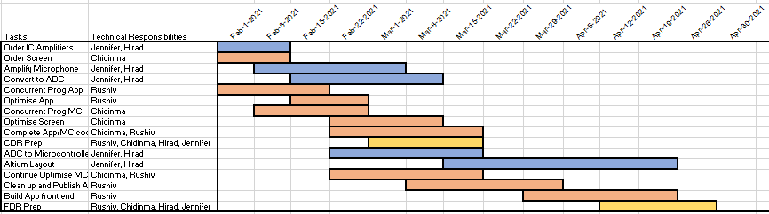
Project Management
Team Coordinator: Rushiv Arora
Altium Lead: Jennifer Gosselin
Budget Management Lead: Chidinma Ejiofor

Slide 23
Thank you!
Questions?

